Slide 1
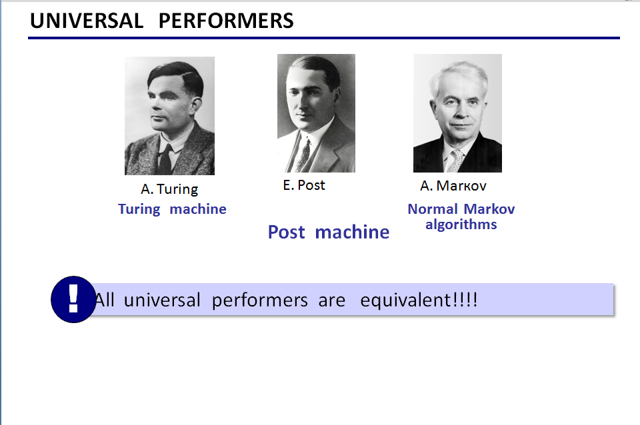
Any algorithm can be represented as a program for a universal performer.
This is the main idea of the theory of algorithms.
Algorithm is a program for a universal performer.

Slide 2
